Slide 1


ES16/ED1 TDM Verification
10-08-2024

Slide 2
Current Verification Status
Verified playback and recording for HS_I2S1(A2B A), HS_I2S2(A2B C) with A2B loopback with bit pattern
Hardware loopback from LPI_I2S3 to HS_I2S3 with bit pattern
Hardware loopback from LPI_I2S2 to HS_I2S4 with bit pattern
Playback and recording with A2B loopback(A2B B) from LPI_I2S3 to LPI_QUA with bit pattern
A2B A network playback with Alpine amplifier and recording with mic
A2B B network playback with 8 channel Panasonic amplifier
A2B C network recording with externally connected mic

Slide 3
Limitations
HS_I2S0 port(connected to internal amplifier) has no hardware or software loopback options so we were only able to verify by probing a known data pattern through oscilloscope.
LPI_QUA can only support 32 channels/32-bit recording.
HS_I2S1 & HS_I2S2 can support only 16 channel/ 16 bit width data(instead of 32 channel) due to Audio reach framework memory limitation. This limitation can be overcome only in the baremetal solution.

Slide 4
Installation and Configuration steps
*Create a new folder Audio in root
*Push below mentioned libraries to /usr/lib64
libmcm.so
libaudio_oem_conf.so
libcsd2.so
libcsd2_client.so
*Push below mentioned binary to /Audio
audio_chime_test_quat_32ch
a2b_test_app.ini
a2b_test_app_loopback
alternatebitpattern.wav
audio_hostless
CCU_A_Loopback.cfg
CCU_B_Loopback.cfg
CCU_C_Loopback.cfg

Slide 5
Installation and Configuration steps
*Push audio oem config file to /etc/audio_oem_cfg
audio_oem.cfg
*Push acdb files to /etc/acdbdata/ADP_AR, delete existing acdb files and replace with the new ones. If permissions are denied then on serial console type setenforce 0 and try again.
acdb files
*Push libstackplus.so to /usr/lib64 in target
*Change Permission- On console type below commands:
cd Audio/
chmod 777 audio_chime_test_quat_32ch
chmod 777 a2b_test_app_loopback
chmod 777 audio_hostless
sync
Reboot

Slide 6
CCU Network B

Slide 7
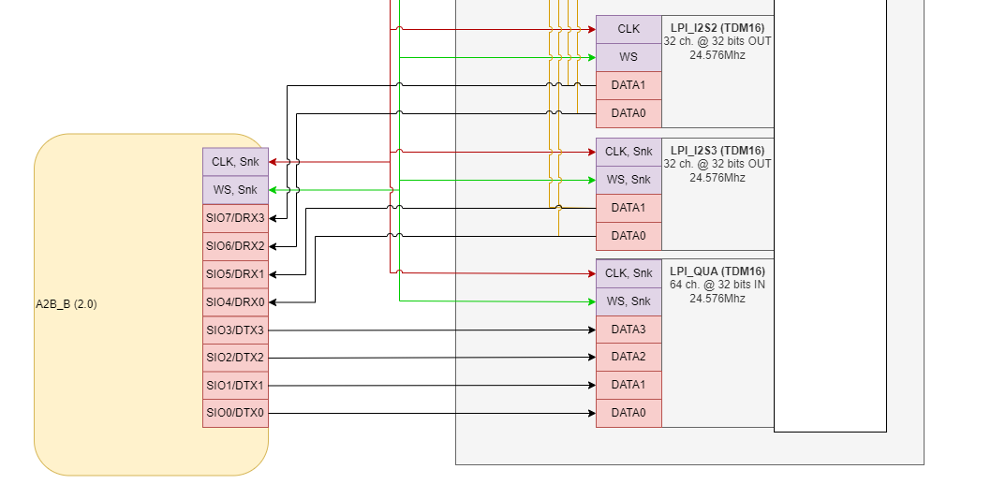
TDM configuration
We are looping back the data from LPI_I2S3 to 4 TX lanes of A2B transceiver as follows:
SIO4/DRX0 -----> SIO0/DTX0
SIO5/DRX1 -----> SIO1/DTX1
SIO4/DRX0 -----> SIO2/DTX2
SIO5/DRX1 -----> SIO3/DTX3

Slide 8
Verification of CCU Network B Loopback
Instructions
Run the a2b test app in background
cd /Audio
./a2b_test_app_loopback --networkB=CCU_B_Loopback.cfg &
Start the playback to push data via all the TDM playback interfaces.
./audio_chime_test_quat_32ch -g 24 alternatebitpattern.wav &
Run the audio record application
./audio_chime_test_quat_32ch -c rec_32_ch_1.wav -m 0 -g 27 48000 32 32 10
Syntax:
audio_ chime_test_quat_32ch -c <Filename> -g <graph_id> <samplerate> <ch> <bitwidth> <duration>

Slide 9
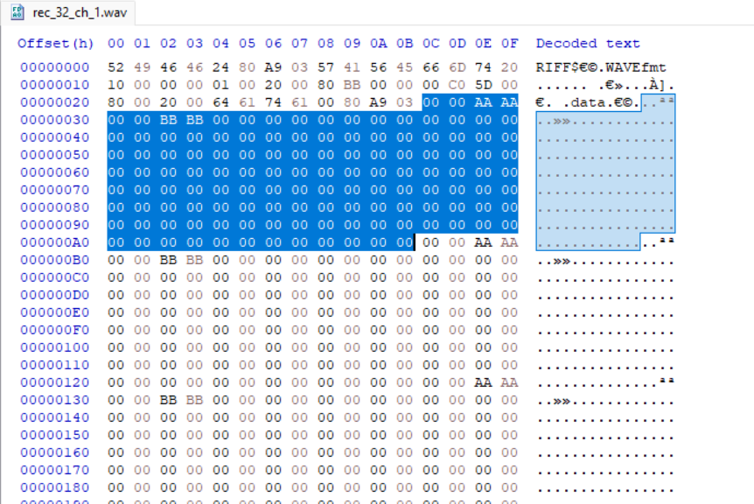
Expected Output
Open the recorded wave file(rec_32_ch.wav) with a hex editor.
Data starts at 0x2c

Slide 10
CCU Network A

Slide 11
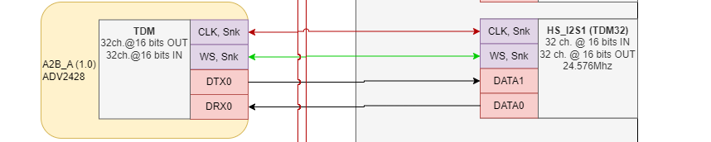
TDM configuration

Slide 12
Verification of CCU Network A Loopback
Instructions
Run the a2b test app in background
cd /Audio
./a2b_test_app_loopback --networkA=CCU_A_Loopback.cfg &
Start the hostless session in background
./audio_hostless –s &
Start the playback to push data via all the TDM playback interfaces
./audio_chime_test_quat_32ch -g 24 alternatebitpattern.wav &
Run the audio record application
./audio_chime_test_quat_32ch -c a2b_mic_16ch_16bit_2.wav -g 24 48000 16 16 10
Download file and open in Hex editor
Syntax:
audio_ chime_test_quat_32ch -c <Filename> -g <graph_id> <samplerate> <ch> <bitwidth> <duration>

Slide 13
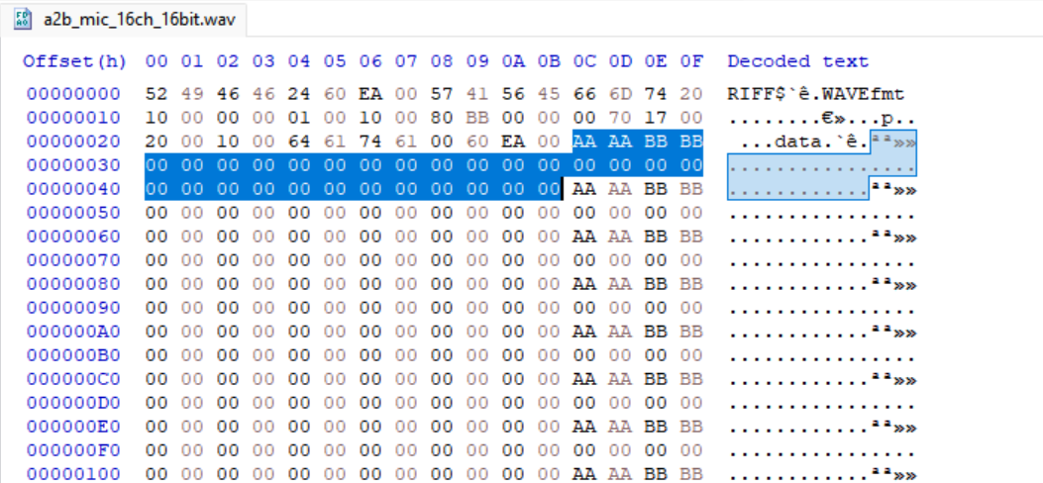
Expected Output
Open the recorded wave file(a2b_mic_16ch_16bit.wav) with a hex editor. Since we are playing a 2-channel wave file, we will have data on the first 2 channels only.

Slide 14
CCU Network C

Slide 15
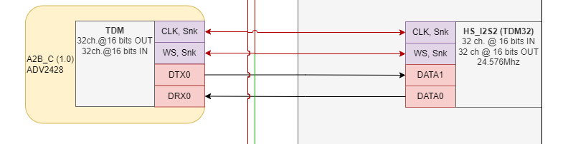
TDM configuration

Slide 16
Verification of CCU Network C Loopback
Instructions
Run the a2b test app in background
./a2b_test_app_loopback --networkC=CCU_C_Loopback.cfg &
Start the hostless session in background
./audio_hostless -s &
Start the playback to push data via all the TDM playback interfaces
./audio_chime_test_quat_32ch -g 24 alternatebitpattern.wav &
Run the audio record applicationc
./audio_chime_test_quat_32ch -c a2b2_mic_16ch_16Bit.wav -g 28 48000 16 16 10

Slide 17
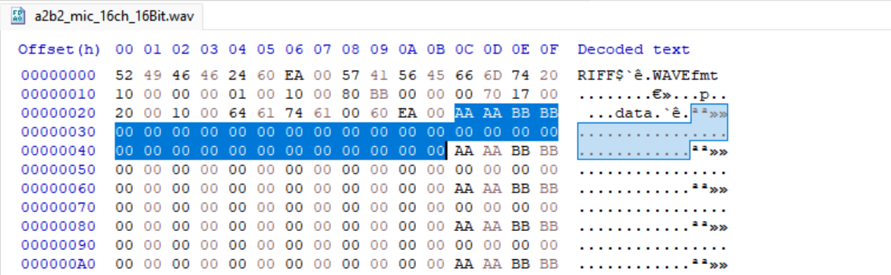
Expected Output
Open the recorded wave file(a2b2_mic_16ch_16bit.wav) with a hex editor. Since we are playing a 2 channel wave file, we will have data on the first 2 channels only.

Slide 18
CCU Hardware Loopback

Slide 19
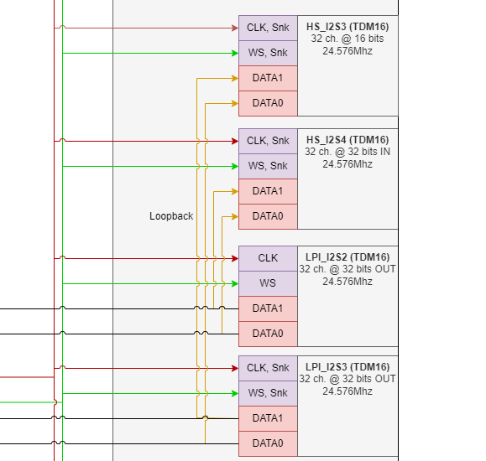
TDM configuration

Slide 20
CCU Hardware loopback
Instructions
Start the hostless session in background
cd /Audio
./audio_hostless -s &
Start the playback to push data via all the TDM playback interfaces
./audio_chime_test_quat_32ch -g 24 alternatebitpattern.wav &
Run the audio record application
For HS_I2S3
./audio_chime_test_quat_32ch -c spk_mic_16ch_32Bit.wav -g 26 48000 16 32 10
For HS_I2S4
./audio_chime_test_quat_32ch -c spk_mic_16ch_32Bit_LPI.wav -g 28 48000 16 32 10

